Slide 1
VIA
CS441
Chris Bliss Matt Chaney Brent Connolly

Slide 2
VIA for Android
An answer for your questions in real time.
What is the name of this statue?
When was this painted?
What automobile maker uses this emblem?
What is the history of this building?

Slide 3
How to use?
Point
Click
???
Profit
Simply take a photo and let Via retrieve relevant information for you.

Slide 4

So who would use VIA?
Anyone who has a question about a recognizable object.

Slide 5
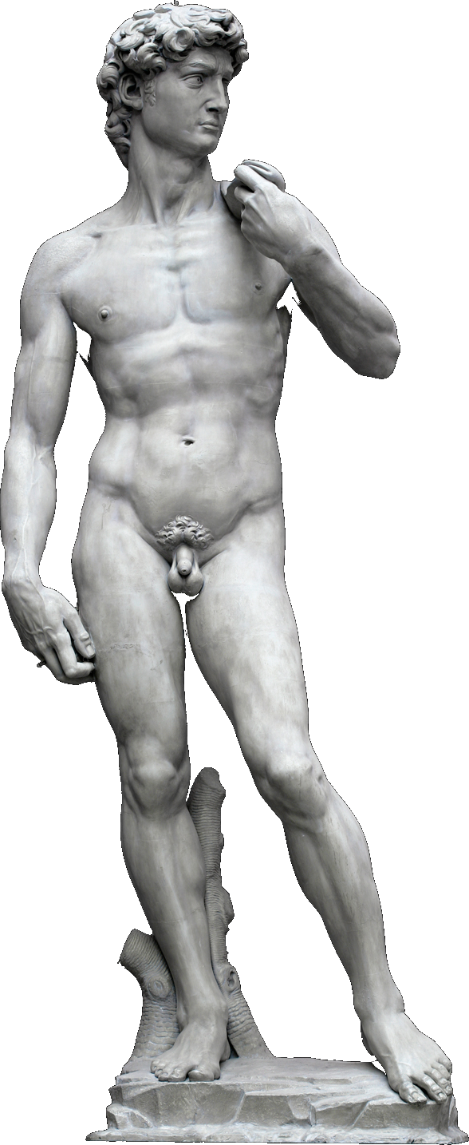

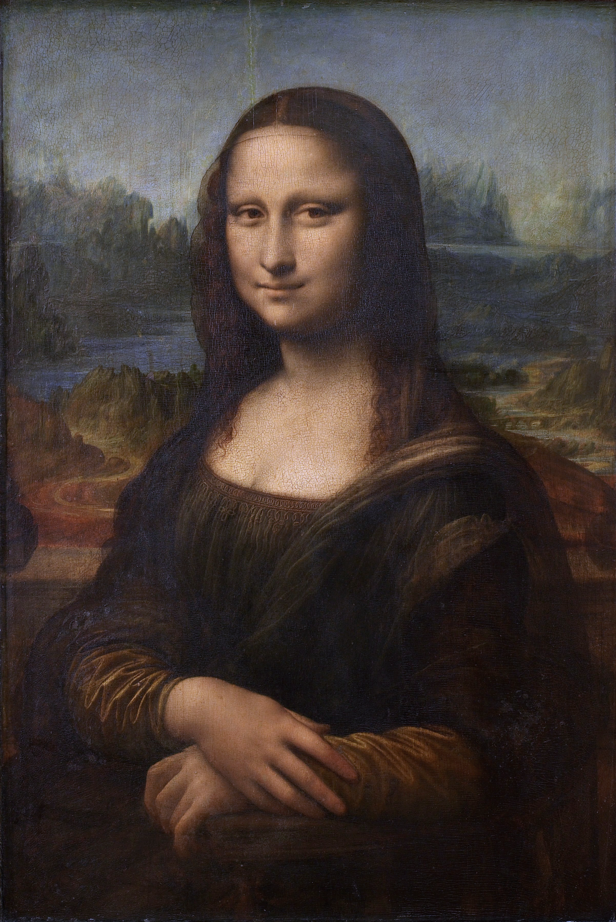
What qualifies as recognizable?

Slide 6
What motivated VIA?
Glass
Originally, the idea of working with wearable technology.
Art
Answering questions about art and making it more approachable with modern technology.
Concept
Just a solid usable concept.

Slide 7
Architecture
Camera
API
Text Parser
Data Retrieval

Slide 8
Components
Camera
Use the native camera and functionality. Once image is taken and approved, the file location is passed to the API class.
API
The image is pushed to a server and then the URL is sent to the Google search API. The results are filtered for Wikimedia.
Text Parser
Once a Wikimedia site is located in conjunction with the image, the HTML of the site is parsed for a title.
Data Retrieval
Once a name has been retrieved from Wikimedia, a Wikipedia search is conducted, the site parsed and then displayed on the device.

Slide 9
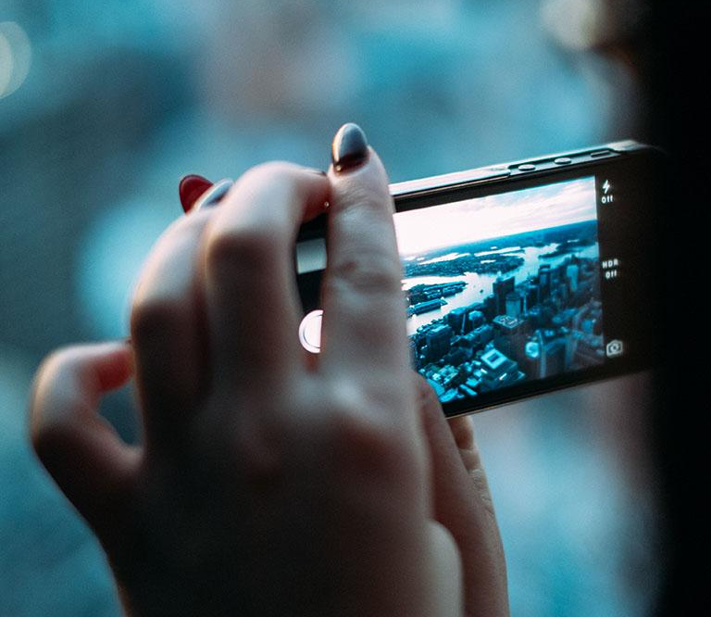
A picture is worth a thousand words
Or sometimes a thousand questions.
Take a picture
Approve image
Image is uploaded to Imgur
Image URL sent to Google API
Results filtered for Wikimedia
Site parsed for object name
Wikipedia searched for name
Site parsed for relevant data
Data displayed

Slide 10
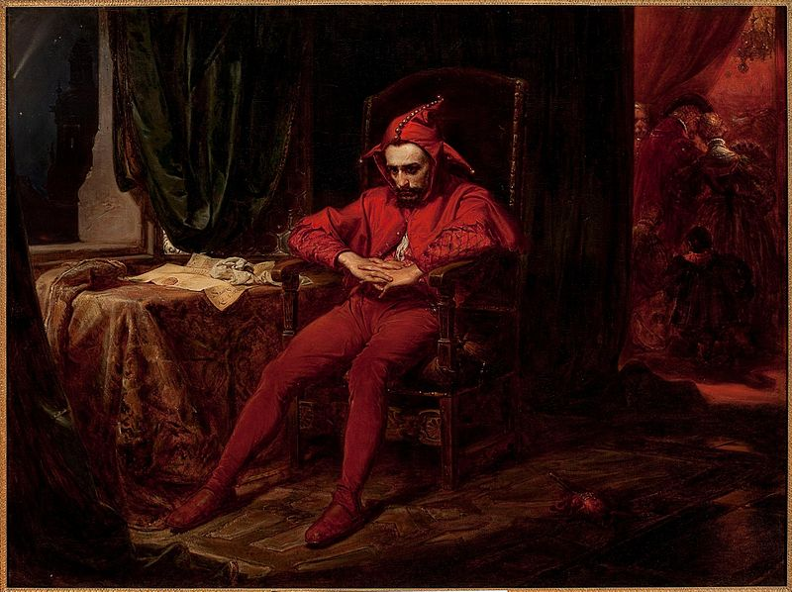
A Moment to Impress
Your bosses significant other is having a painting hung in a museum and you were invited. You find this painting and feel that you related to the bored looking man in the silly hat. However, you’re approached by your boss and they ask your opinion about the piece. What could you say about it?

Slide 11
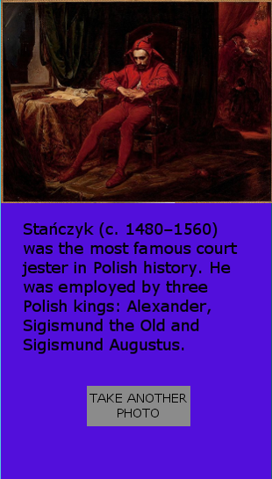
Place your screenshot here
VIA
Use the technology in your pocket to learn more about the world around you now.

Slide 12
Chris
Matt
Brent

Slide 13

Chris Bliss
Implemented camera functionality and talked.

Slide 14

Matt Chaney
API calls and text parser.

Slide 15

Brent Connolly
Data display and GPS functionality.

Slide 16
Lessons Learned Matt – “I learned that a theoretic approach might not be workable.” Chris – “I learned that a concept might be constrained by your imagination” Tricks If you have uses-permission then Android checks for that feature for you.

Slide 17
Future!
Complete GPS functionality
Create upload database for images that return bad data or fail to return data
UI/UX development
Connect to social media
Image editing & retention
Provide sustainability through ad revenue

Slide 18
Thanks!
Any questions?

